Slide 1
MAP with LAMBDA
The MAP function is useful when you want to process each item in an array individually but as an array operation that yields an array result. MAP is also useful when the formula logic is complex and would be best managed in a single location. Using a named LAMBDA function with MAP is possible to reuse the same code elsewhere.
=MAP({1,2,3},LAMBDA(a,a+1)) // returns {2,3,4}
=MAP(B5:D16,LAMBDA(a,IF(ISNUMBER(a),+a,"")))
=MAP({1,2,3},{1,2,3},LAMBDA(a,b,a+b)) // returns {2,4,6}
=MAP(array,LAMBDA(a,a+1))
=MAP(rng1,rng2,rng3,LAMBDA(a,b,c,MAX(a,b,c)))

Slide 2
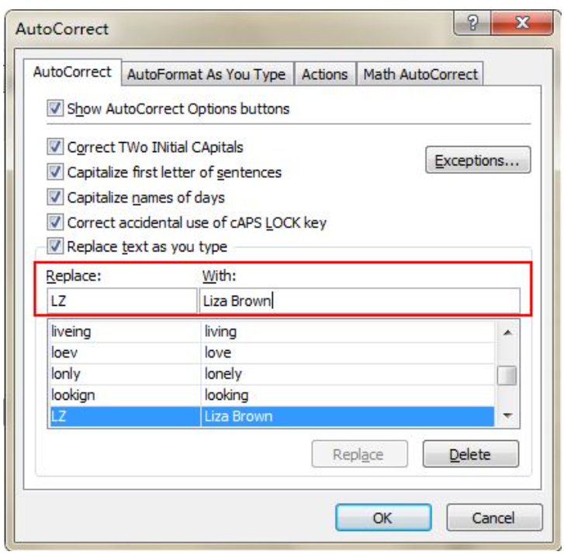
Speed up Inputting Complicated Terms with AutoCorrect
If you need to repeat the same value and it is complicated to input, the best way is to use the AutoCorrect function, which will replace your text with the correct text. Take my name, Liza Brown, for example, which can be replaced by LZ. Therefore, every time I input LZ, it can autocorrect to Liza Brown. Go to File->Options->Proofing->AutoCorrect Options and input Replace text with correct text in the red rectangular area, as below.

Slide 3
Debugging Formula
To debug a formula:
Select the cell that has the formula.
Go to Formulas –> Formula Auditing –> Evaluate Formula (Keyboards Shortcut Alt + TUF).
Click on Evaluate to see the steps the formula is evaluated by Excel.

Slide 4
Delete all comments
Select all the cells.
Go to Home –> Editing –> Find and Select –> Go to Special.
Select Comments in the Go To Special Dialogue box.
Click OK.
This will select all the cells that have comments in it. Now go to any of the selected cells, right click and select Delete comment

Slide 5
Importing data from Web URL
Select Data > Get & Transform > From Web.
Press CTRL+V to paste the URL into the text box, and then select OK.
In the Navigator pane, under Display Options, select the Results table. Power Query will preview it for you in the Table View pane on the right.
Select Load. Power Query transforms the data and loads it as an Excel table.

Slide 6
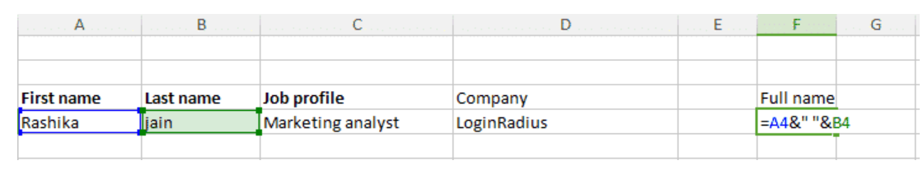
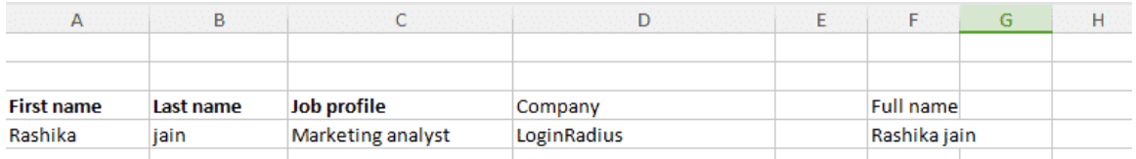
Compose text with “&”:

Slide 7
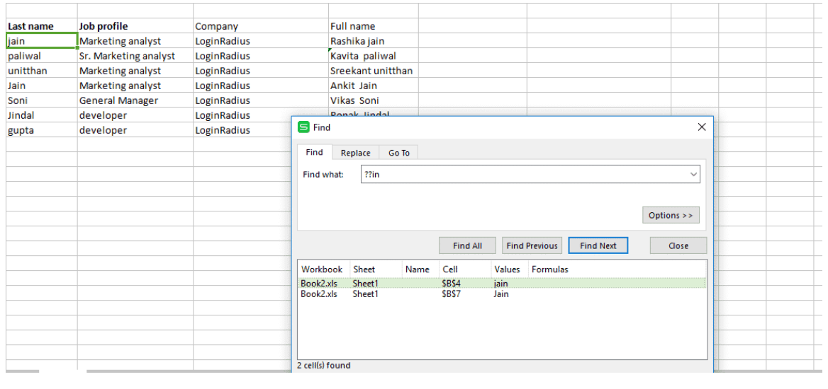
Vague search with Excel’s wildcard Character!
In Excel “Question mark(?)”, “Asterik(*)”, and “Tilda(~)” are the wild card characters that are used to complete your search.
Question mark (?) : can take a place of single character. For example “L?gs” matches with Logs, Legs but not with “”Lungs”
Asterik (*) : can take place of any number of characters. In the above example if we replace “?” with “*” like “L*gs” then it gives results that matches with Logs, Legs and lungs as well.
Tilda (~) : It indicates that following character should be treated as a normal character not as a wildcard character. For example “L~?gs” will match with only “L~?gs”.

Slide 8
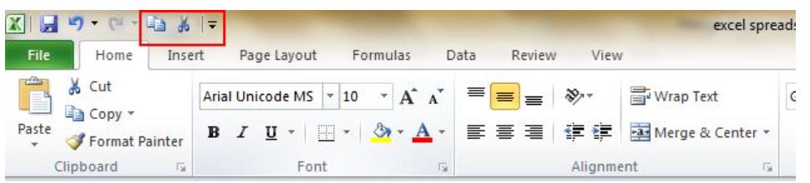
Custom Shortcut menu
Usually, there are three shortcuts on the top menu. These are Save, Undo Typing, and Repeat Typing. Nevertheless, if users want to apply or use more shortcut options such as Copy and Cut then they can set them up by following these steps: File->Options->Quick Access Toolbar, add Cut and Copy from the left column to the right, save it

Slide 9
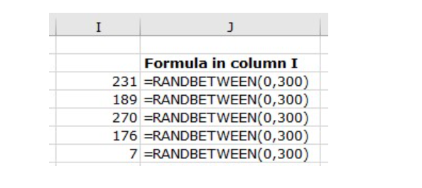
RANDBETWEEN Function
=RANDBETWEEN(starting_point, end_point)

